Slide 1
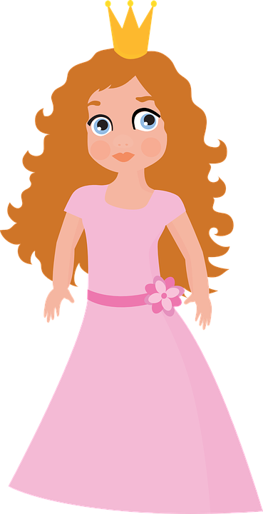
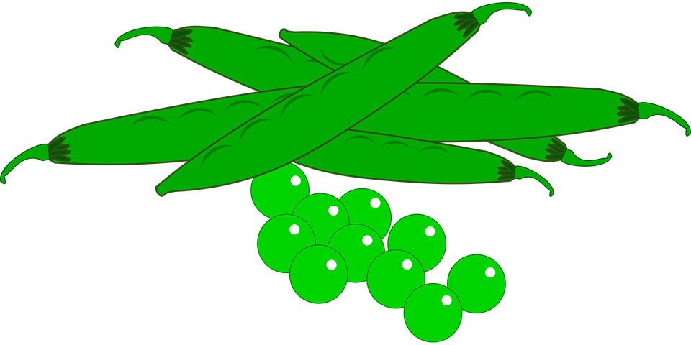
THE PRINCESS AND THE PEA

Slide 2
Who is the author?
HANS
CHRISTIAN
ANDERSEN

Slide 3
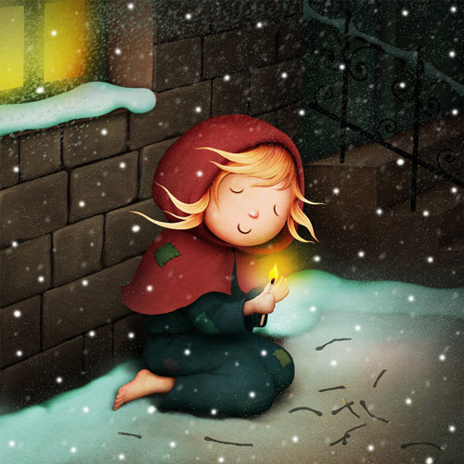
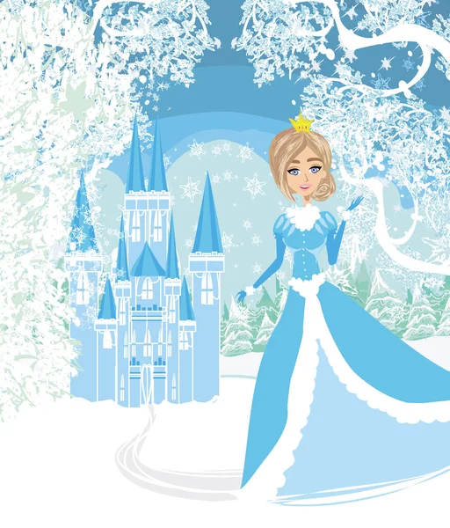
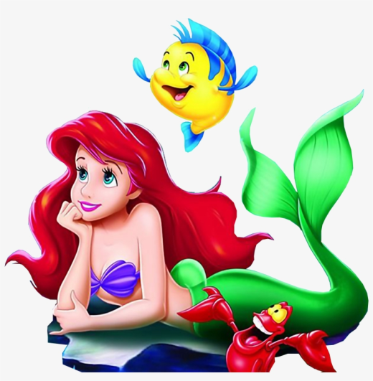
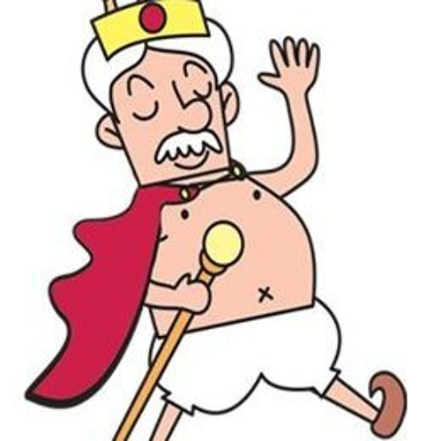
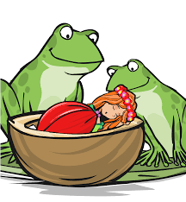
What his stories do you know?

Slide 4
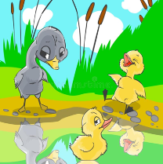
1.
2.
3.
4.
5.
6.
A –THE EMPEROR’S NEW
CLOTHES
B – THUMBELINA
C – THE LITTLE MATCH
GIRL
D – THE SNOW QUEEN
E – THE UGLY DUCKLING
F – THE LITTLE MERMAID

Slide 5
Where is H.C. Andersen from?
DENMARK

Slide 6
Where is Denmark?

Slide 7
Denmark is a SCANDINAVIAN country
DENMARK
SWEDEN
NORWAY
FINLAND

Slide 8
The capital city is…
Copenhagen
Cøbenhavn

Slide 9
In Denmark you can …
Walk on sandy beaches.
See the statue of The Little Mermaid.

Slide 10
Danish people like…
cycling
Their Royal Family

Slide 11
What is also Denmark famous for?

Slide 13
pronounciation

Slide 14
Hygge is an ART OF HAPPINESS.
Enjoying the present calming moment
Enjoying cozy moments
Enjoying everyday relaxing moments
Enjoying cocoa by candlelight
Doing things that make you feel CALM, COSY, RELAXED
Doing things that make you feel HAPPY WITH YOURSELF

Slide 15
What can those things be?

Slide 16
Anything!!!
What do you like doing?

