Slide 1
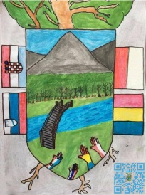
Ethics and Mediation in school
Made for the project:
Terra Community and Ethics of the Future

Slide 2
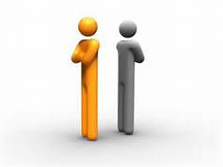
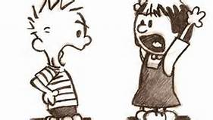
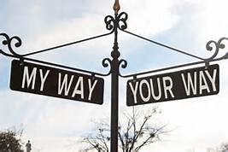
Conflict?
What is a conflict?
Why does the conflict develop?

Slide 3
Definition of a conflict
Verb 1. to come into disagreement; be contradictory, at variance, or in opposition;
2. to fight or contend; do battle.
Noun
3. a fight, battle, or struggle, especially a prolonged struggle; strife.
4. controversy; quarrel: conflicts between parties.
5. discord of action, feeling, or effect; antagonism or opposition, as of interests or principles: a conflict of ideas.
6. a striking together; collision.
7. incompatibility or interference, as of one idea, desire, event, or activity with another: a conflict in the schedule.
8. Psychiatry. a mental struggle arising from opposing demands or impulses.

Slide 4
How to deal with conflicts?
https://www.youtube.com/watch?v=KY5TWVz5ZDU
How you deal with conflicts at work (with students, other colleagues, …)?
How you deal with conflicts at home?

Slide 5
CONFLICT RESOLUTION STYLES
Avoid (to stay away from someone or something, or prevent something from happening, or not allow yourself to do something)
Accommodate (to give what is needed to someone)
Compete (to do an activity with others and try to do better than they do)
Compromise (an agreement between two sides who have different opinions, in which each side gives up something it had wanted)
Collaborate (to work together or with someone else for a special purpose)

Slide 6
MEDIATION
Mediation is a dynamic, structured, interactive process where a neutral third party assists disputing parties in resolving conflict through the use of specialized communication and negotiation techniques. All participants in mediation are encouraged to actively participate in the process. Mediation is a "party-centered" process in that it is focused primarily upon the needs, rights, and interests of the parties. The mediator uses a wide variety of techniques to guide the process in a constructive direction and to help the parties find their optimal solution (https://en.wikipedia.org/wiki/Mediation)
http://www.center-mi.si/mediacija.html

Slide 7
THE MEDIATOR’S ROLE
What it is NOT:
- To be a detective - get information and stop
- To be an arbitrator - decide the best out come
The Mediator structures the process to
• separates our emotions,
• moves from positions to interests,
• channels communication between the parties,
• provides a reality check,
• initiates brainstorming & generation of options,
• creates opportunities to see the otherside,
• identifies the signposts of agreement.

Slide 8
Listening is Important and Powerful
• Good listening is helpful in and of itself - if you do
nothing else in mediation …
• Builds trust and rapport
• Deescalates/calms
• Creates clarity
• Listening is a precursor to problem-solving
• Feels like a“gift”- everyone wants to be heard
Exercise: listen to your partner (1min)

Slide 9
Active Listening Skills
• Get the Story
• Probe / Clarify Meanings
• Listen for Emotions
• Summarize
• Value Silence

Slide 10
Get the Story
• Encourage the speaker
• Ask open-ended questions
• Draw out background/context
• Clarify and check understanding

Slide 11
Clarify Meanings Probe
• Use questions that take the speaker’s understanding a step deeper
“What is your concern about that?”
“What do you mean by ‘disrespect’?
“Why do you think she did that?”
“How do you think he sees this issue?”

Slide 12
Listen for (and Respond to) Emotions
• Be aware of non-verbal cues
(hesitation, change in tone, body language
• Name the emotion in away that validates it.
(when in doubt, stay general)

Slide 13
Summarize
• Make a“story” out of what you’ve heard
• Capture what’s most important to the speaker
• Include main facts, issues, concerns, feelings,perception
• Check accuracy
“You’ve said a lot. Let me see if I understand…”
“So the issues you’reconcerned about are X, Y,Z, and it sounds like the biggest one for you is Z.
Is that right?”

Slide 14
Value Silence
• Shows concern, empathy, respect
• Allows people to hear themselves, and each other
• Watch non-verbal cues
• Let people answer questions

Slide 15
PEER Mediation
https://m.youtube.com/watch?v=ynBhMQDT7Kw
Peer mediation is a program and a process, where students of the same age-group facilitate resolving disputes between two people or small groups.
The process is voluntary for both sides. Peer mediators do not "make decisions" but rather work towards a win-win resolution for both sides in order to avoid further trouble.

Slide 16
Steps of Mediation:
Defining the situation
Understanding the situation (gatering information)
Finding a solution (Brainstorming Solutions @ Writing the Agreement)

Slide 17
Basic Mediation Training: TRAINERS’ MANUAL
From Carol Orme-Johnson and Mark Cason-Snow

